Slide 1
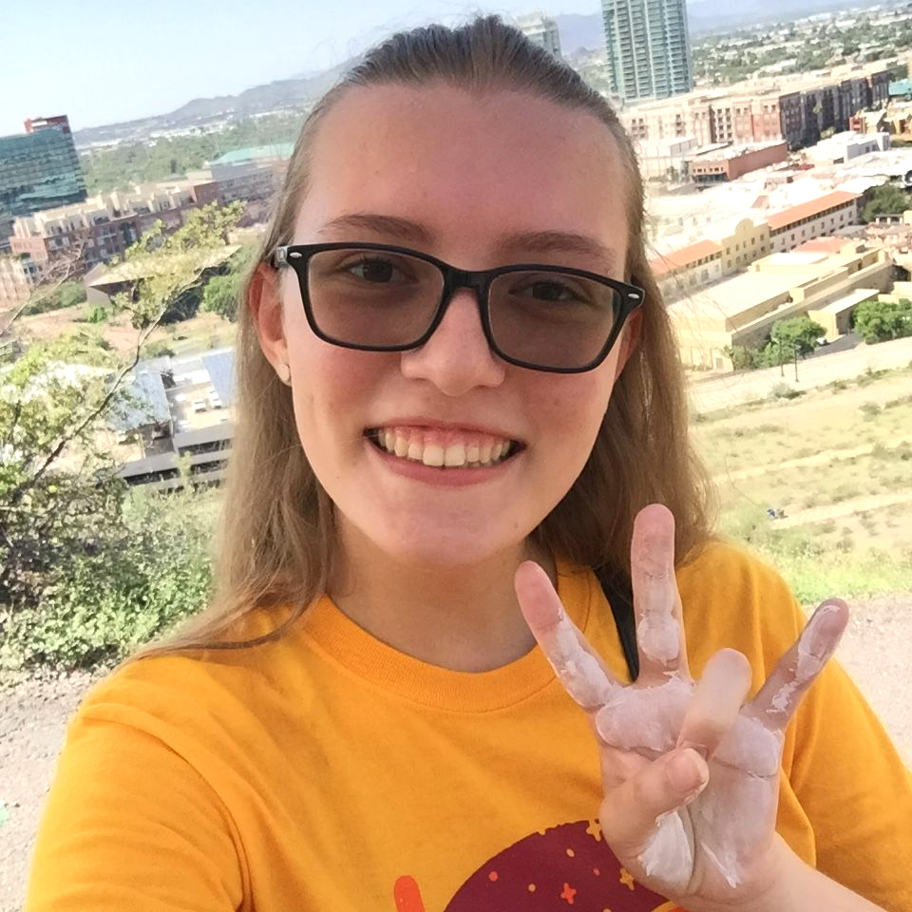
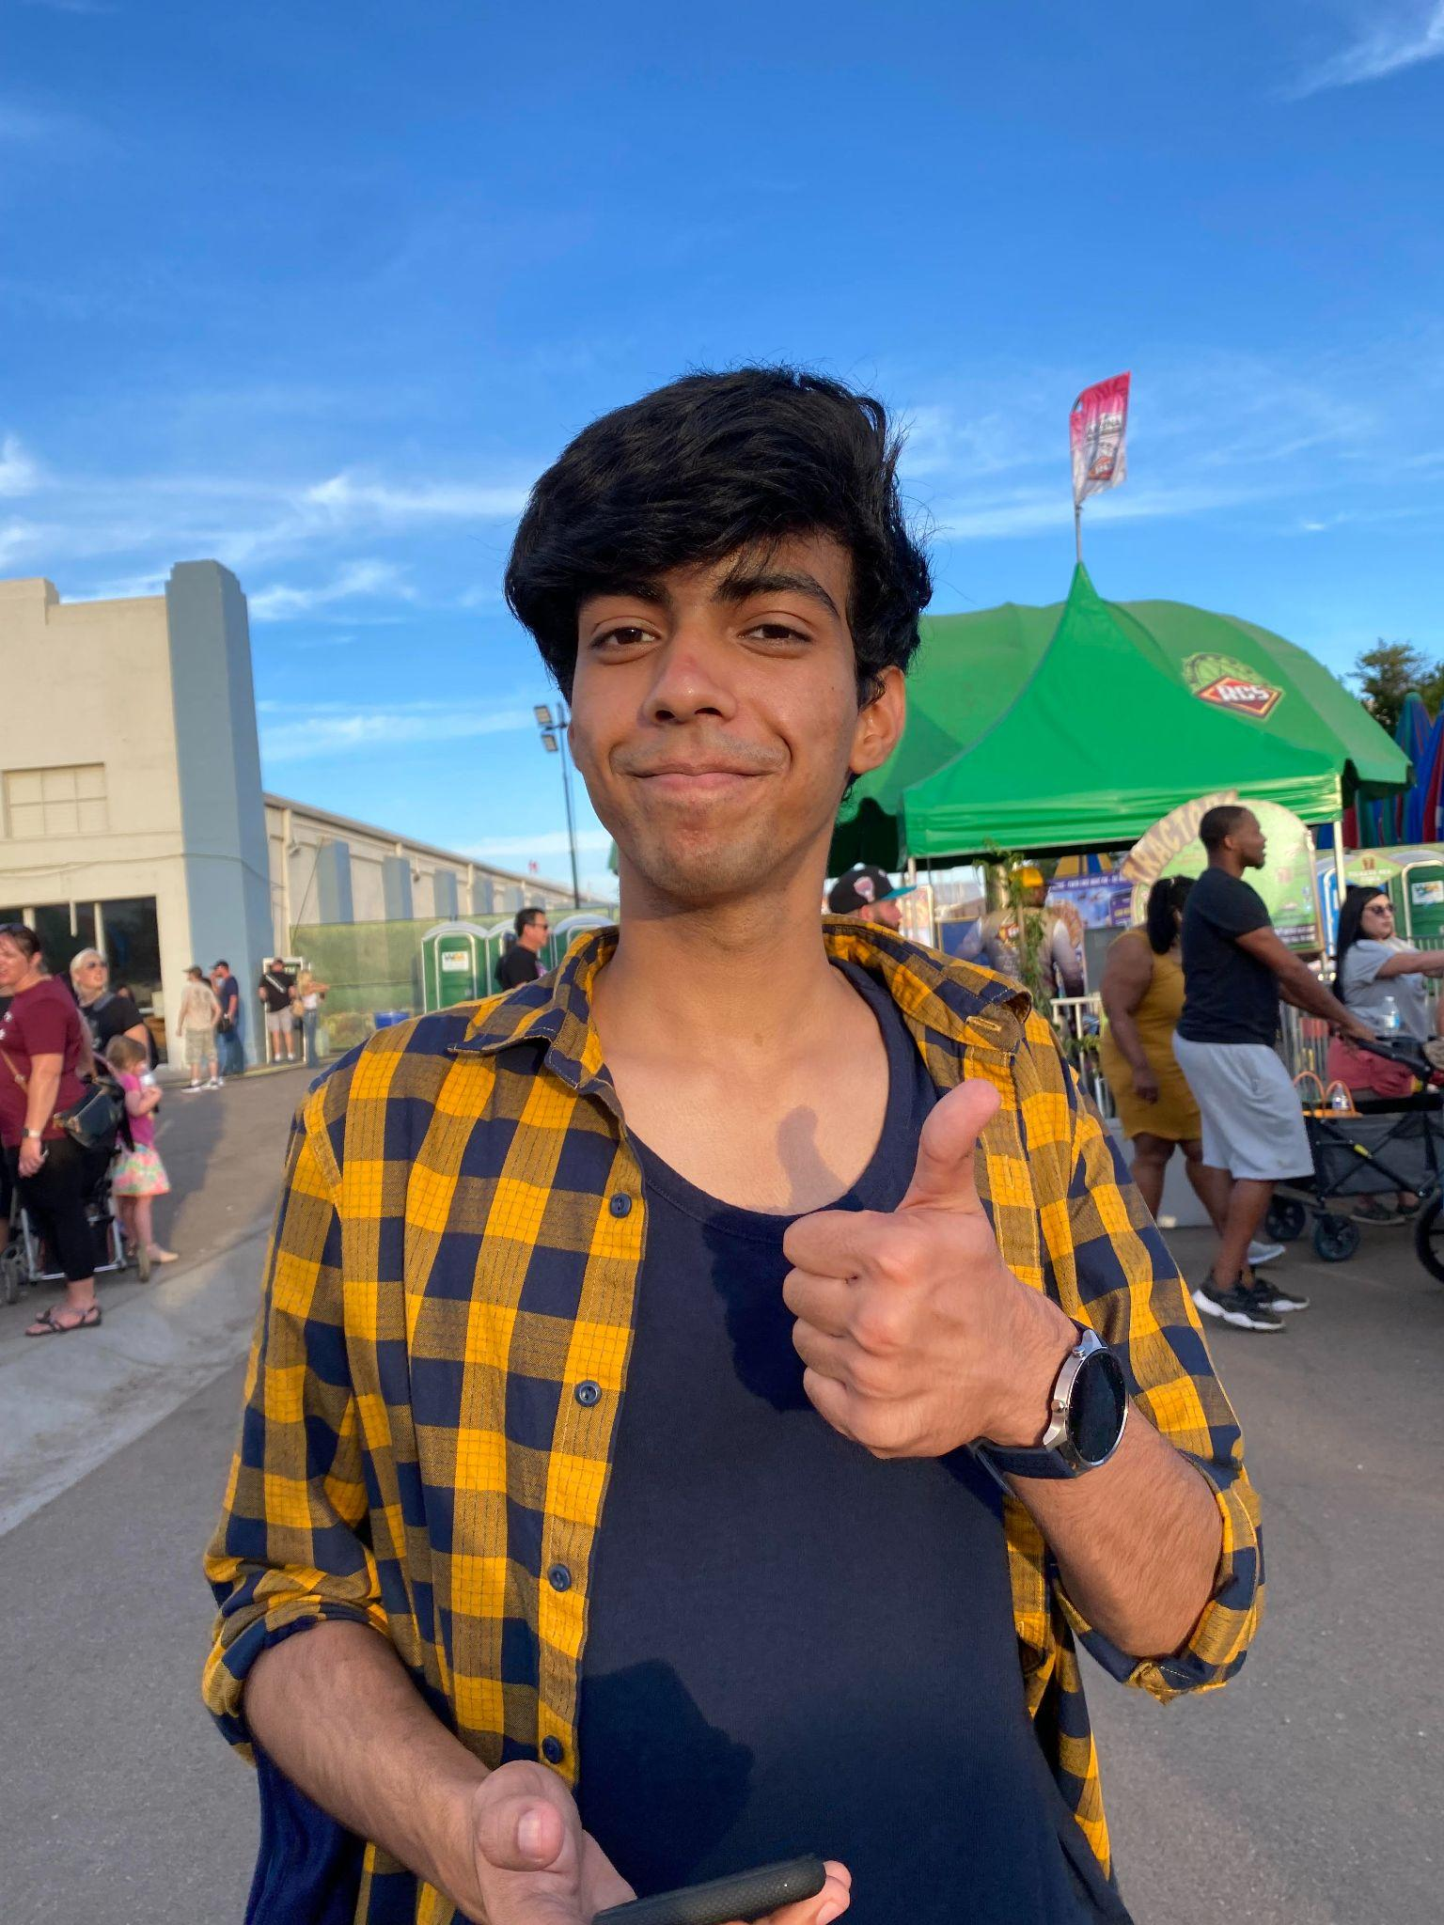
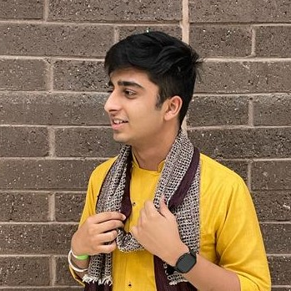
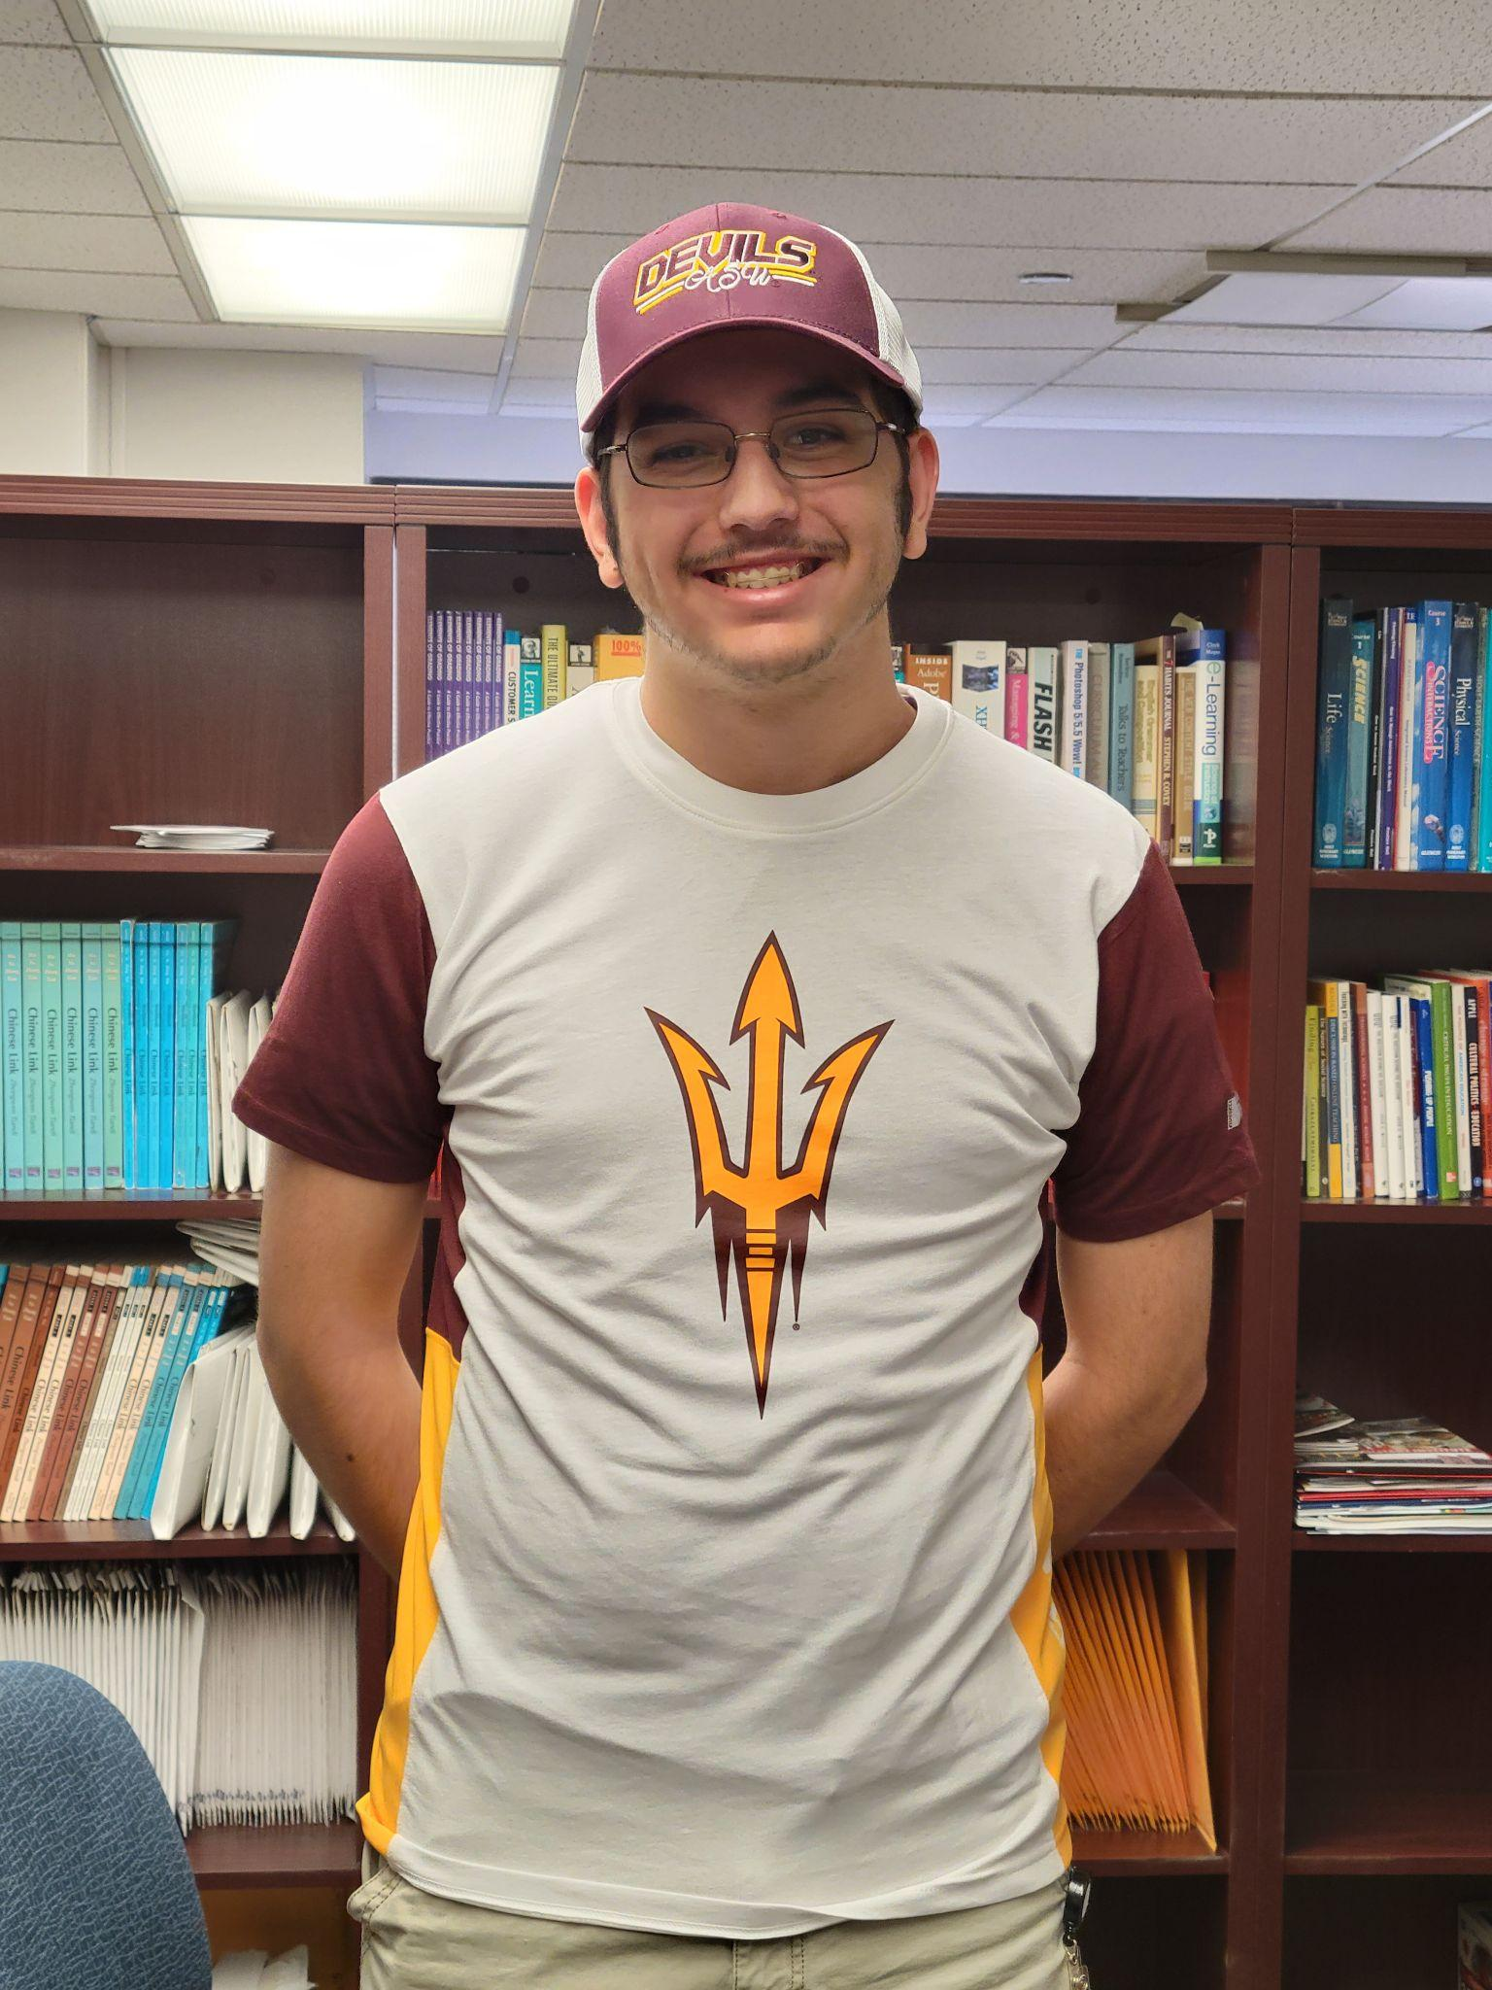
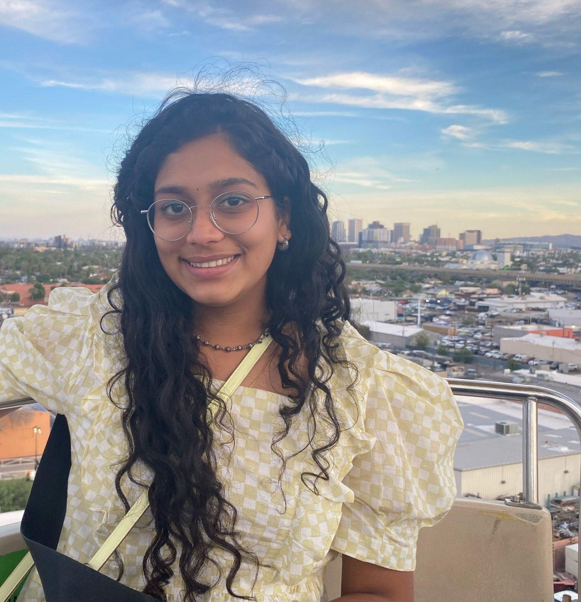
Meet the Developers
Marcella Alexander
Neel Madhav Dogra
Animation
Computer Science
Nishit Grover
Nathan Lathrum
Sindhu Rallabhandi
Computer Science
Software Engineering
Computer Science

Slide 2

ASU Cloud Scholars Hackathon 2021!
APItite
Diet-needs met, REST assured

Slide 3
HEALTH
&
ACCESSIBILITY
Our Main Categories

Slide 4

.THE. .INSPIRATION.

Slide 5
Research
More Research
cdc.gov/mmwr/volumes/66/wr/mm6615a2.htm
Food allergies → 15 million Americans
30,000 annual emergency department visits
150–200 deaths each year
½ of fatal reactions → caused by food from a restaurant or other food service establishment
statista.com/chart/24791/share-of-americans-who-who-follow-nutritional-rules/
57% of Americans monitor/restrict 1+ nutritional component in their diet

Slide 6
THE PROBLEM
Difficulty finding foods within dietary restrictions when ordering online
HEALTH
ACCESSIBILITY
Nutrition
Safety
User experience (UX)
Standardized

Slide 7






OUR ARSENAL
LANGUAGES USED
AMAZON WEB SERVICES USED
S3 - Bucket
DynamoDB
Lambda
Gateway API

Slide 8
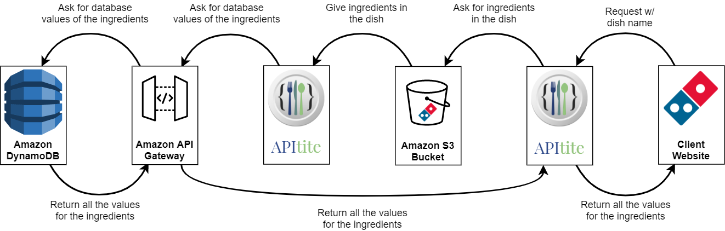
Logical Architecture Diagram
Notes:
Nathan

Slide 9
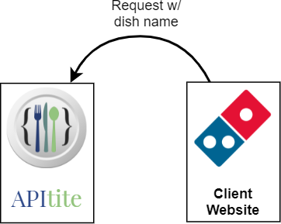
1. GET request sent to API
Notes:
Nathan

Slide 10
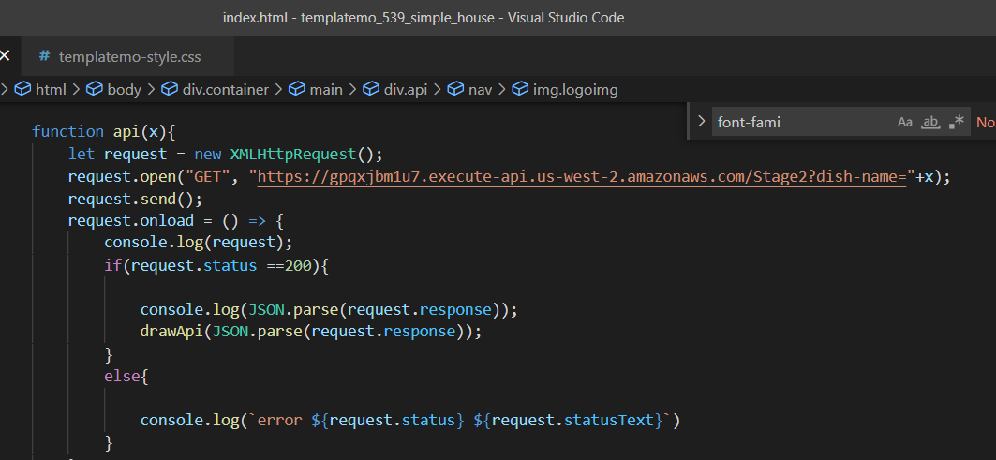
2. Javascript used to connect to API
Dish name given through GET request

Slide 11
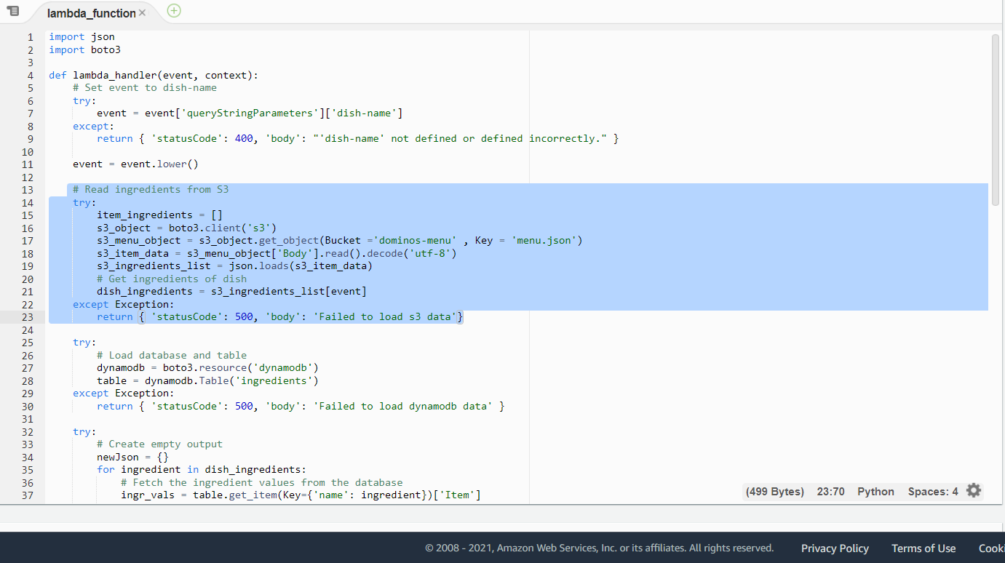
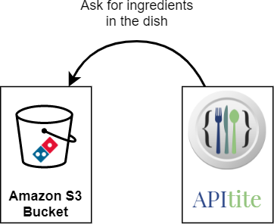
2. Dominos menu data fetched from S3

Slide 12
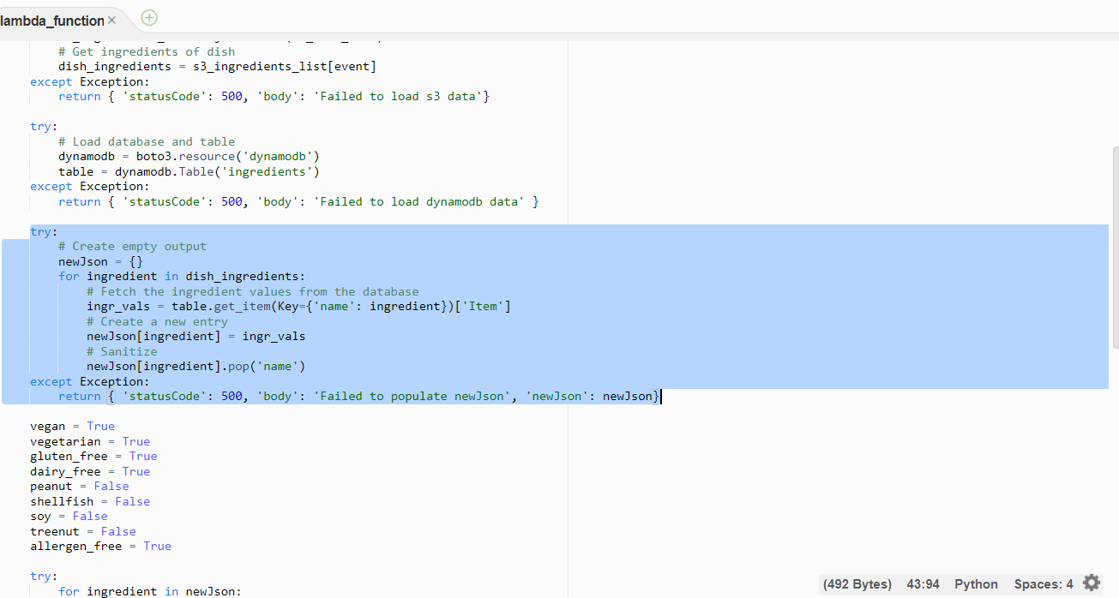
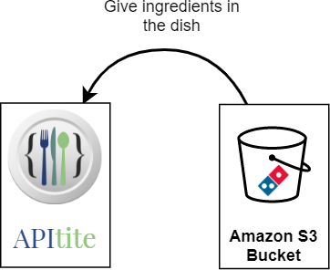
3. Read JSON through Lambda
JSON parsed into a javascript object newJson

Slide 13
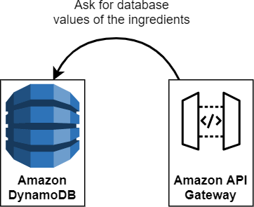
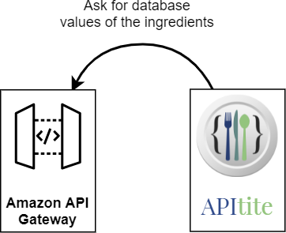
4 & 5. API’s ingredients database fetched from
DynamoDB

Slide 14
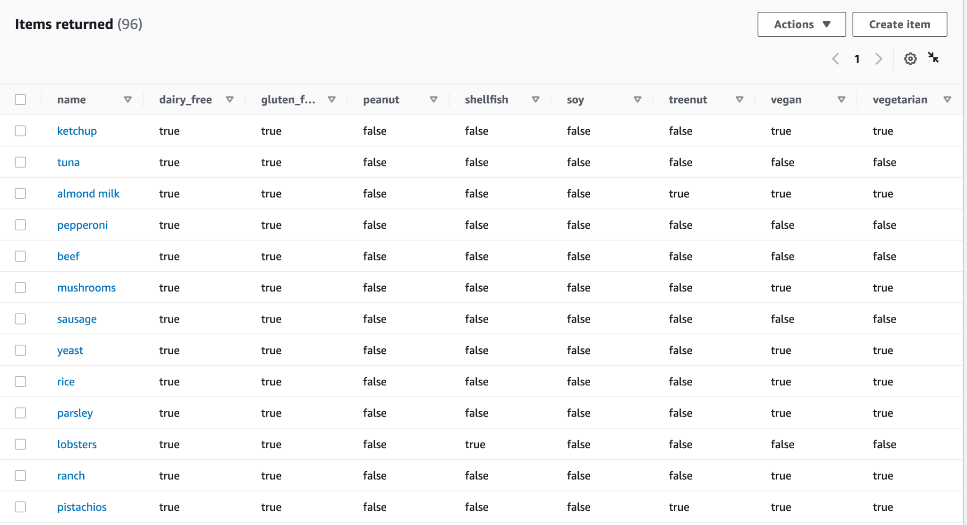
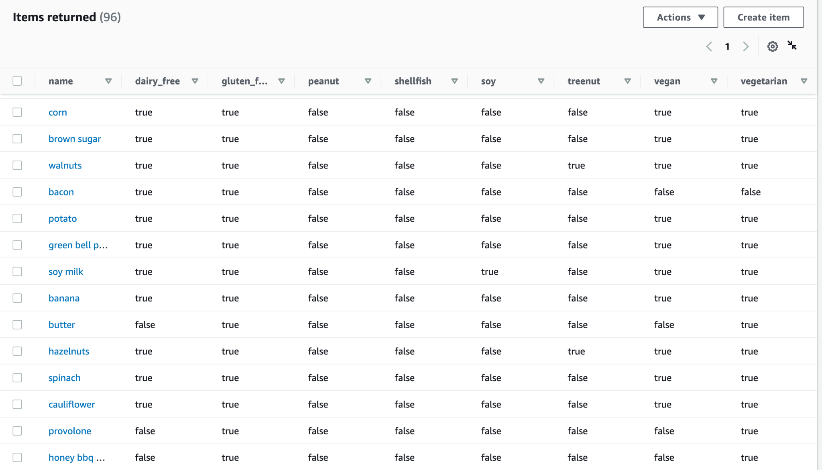
DynamoDB Screenshots

Slide 15
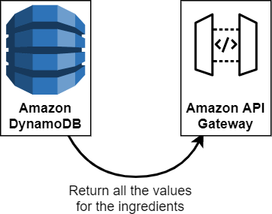
6. Evaluate an item’s ingredients properties

Slide 16
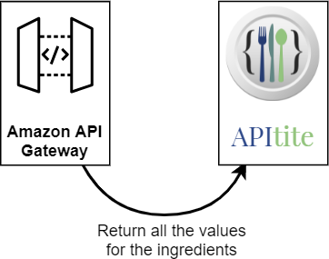
7. API returns JSON of an item’s data

Slide 17
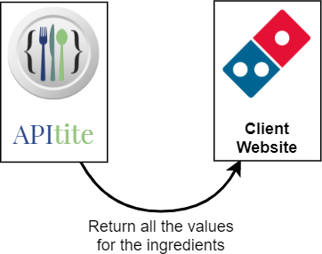
8. Website JavaScript receives JSON
JSON response parsed

Slide 18
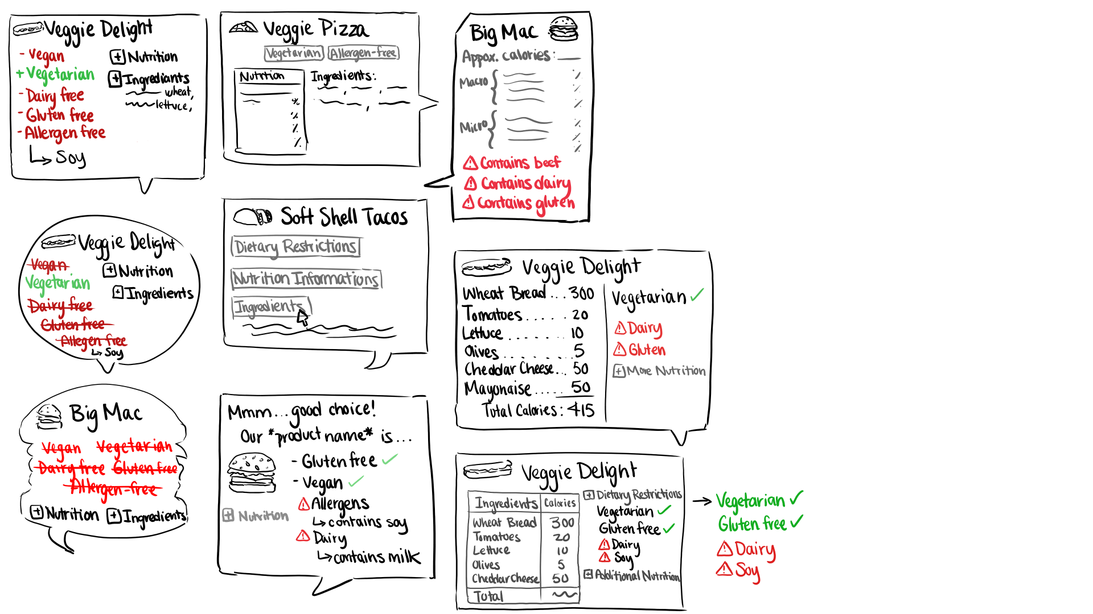
UI Ideas

Slide 19

Thank you!
Questions or feedback?

